Slide 1
Chatbot Therapy
Name: Le Duc Nghia ID:14706
Major: Computer Science Engineering Superviser: Dr. Ngoc Tran Hong
Co-Supervisor: Dr. Dinh Quang Vinh

Slide 2






Table of contents
01
02
03
Introduction
Motivation
Idea
04
05
06
Data Processing
Model
Conclusion

Slide 3

01
Introduction

Slide 4

Two columns
Purpose
Create a chatbot that can recognize emotions through facial expressions, voice, and some psychology quests to understand your current emotions in order to provide therapeutic methods and empathy to help you overcome daily life issues with practical advices.

Slide 5
02
Motivation

Slide 6



Motivation
Vietnam
Developed countries
General Motivation

Slide 7

Motivation
Develop countries
Psychology plays a vital role in understanding mental health. Developed countries like the United States, Europe, and Japan prioritize mental health development to improve their citizens' quality of life.

Slide 8

Motivation
Vietnam
In Vietnam, psychology has been a distant concern during the past 10-20 years of focusing on economic growth. However, at the present with the improved economy, there is now a growing interest in mental health among the population.

Slide 9

Motivation
General motivation
This chatbot supports healthcare professionals in providing mental health therapy, improving quality of life, and promoting awareness of the value of mental well-being for a happier society.

Slide 10

03
Idea

Slide 11


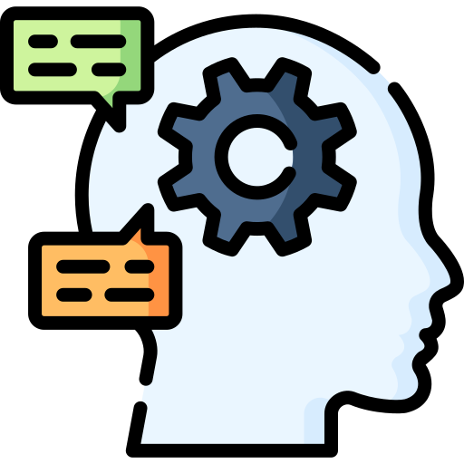

Idea
Emotion Recognition
Survey quests suggestion
Natural Language Preprocessing
Positive solutions

Slide 12
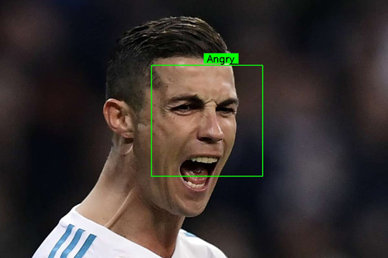

Idea
Emotion Recognition
Facial Emotion Recognition: Recognizing several emotions:
Angry, Disgust, Fear, Happy, Sad, Surprise,
Neutral

Slide 13
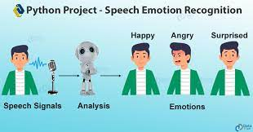
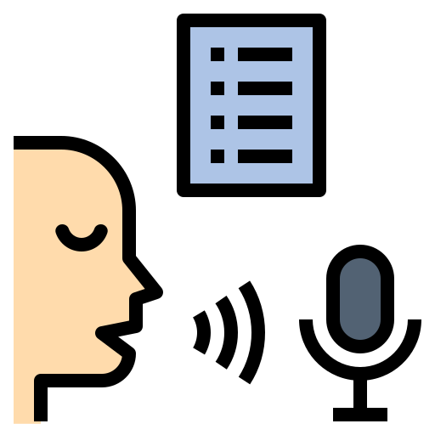
Idea
Emotion Recognition
Voice Emotion Recognition: Recognizing several emotions:
Angry, Disgust, Fear, Happy, Sad, Surprise,
Neutral

Slide 14
Idea
Natural Language Preprocessing
Understanding human languages and Psychology concepts

Slide 15
Idea
Positive solutions
Able to understand people emotion deeply and give some positive feedbacks

Slide 16
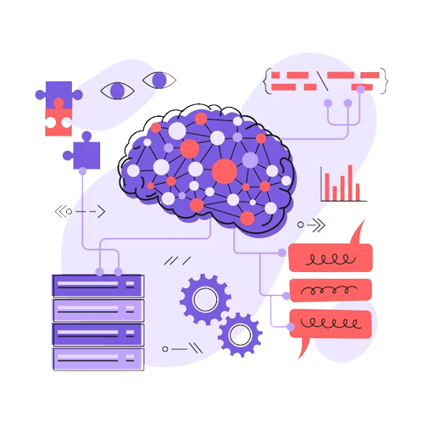
04
Modeling

Slide 17

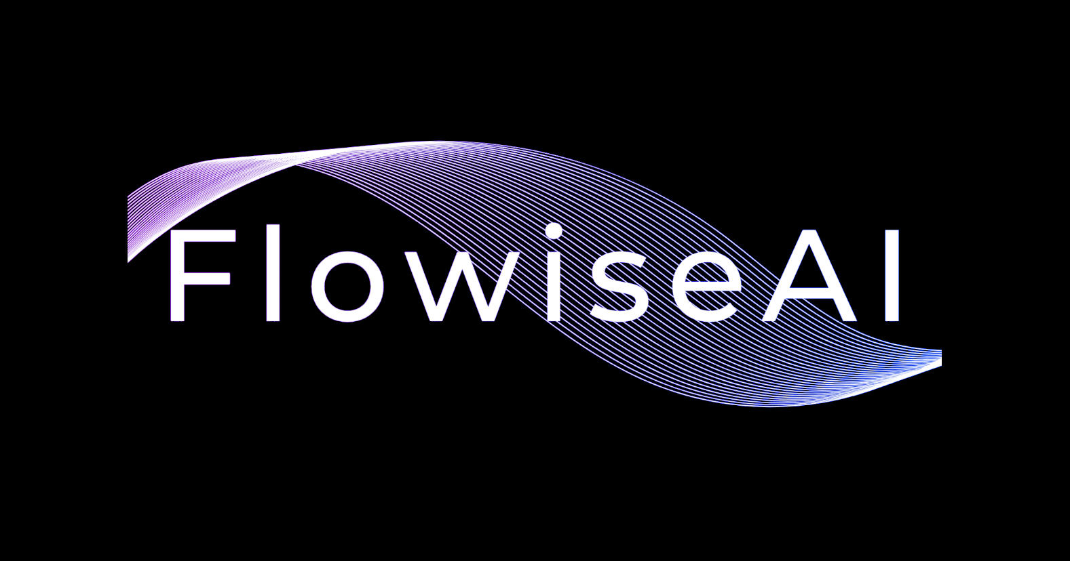
Modeling

Slide 18

Modeling
Hugging Face
Hugging Face is a company and open-source community focused on NLP and machine learning. They are known for their Transformers library, which offers pre-trained models for various NLP tasks. Hugging Face provides user-friendly tools and resources to help developers build and deploy advanced NLP models.
https://huggingface.co/

Slide 19
Modeling
Hugging Face
Hugging Face is a company and open-source community focused on NLP and machine learning. They are known for their Transformers library, which offers pre-trained models for various NLP tasks. Hugging Face provides user-friendly tools and resources to help developers build and deploy advanced NLP models.
https://huggingface.co/

Slide 20
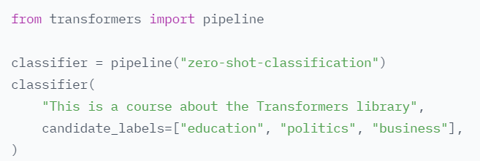
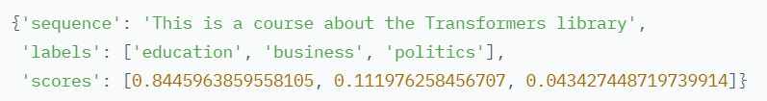
Modeling
Hugging Face
Application:
Zero-shot classification NLP

Slide 21
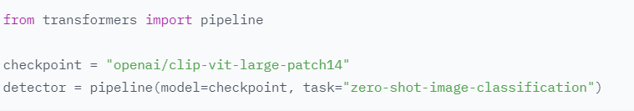
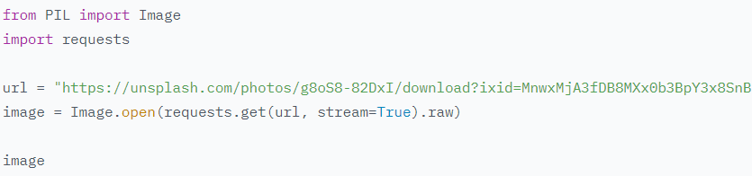
Modeling
Hugging Face
Application:
Zero-shot classification Image

Slide 22

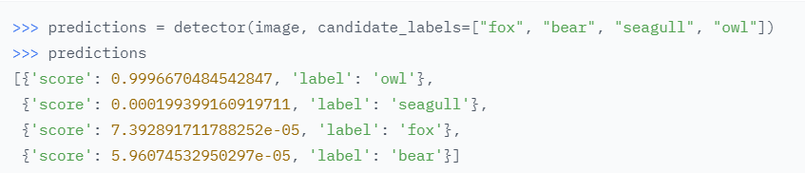
Modeling
Hugging Face
Application:
Zero-shot Image Classification

Slide 23
Modeling
FlowiseAI is an open source UI visual tool that helps in building customized LLM (Language Learning Models) flow using LangchainJS.

Slide 24
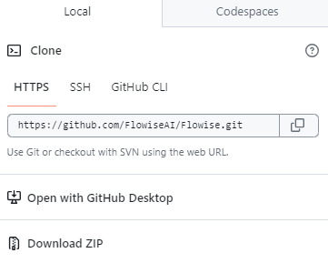
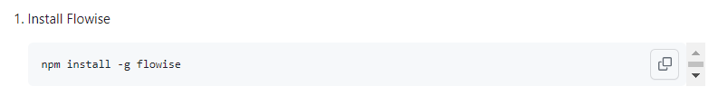
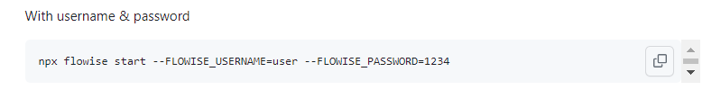
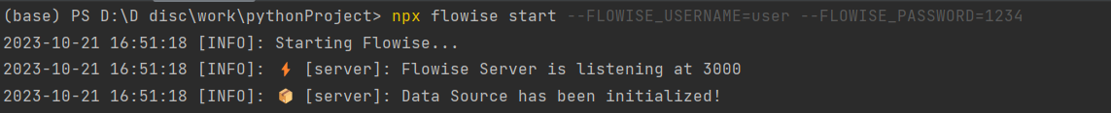

Modeling
FlowiseAI
How to setup:
Open the AI model
https://github.com/FlowiseAI/Flowise
https://localhost:3000

Slide 25
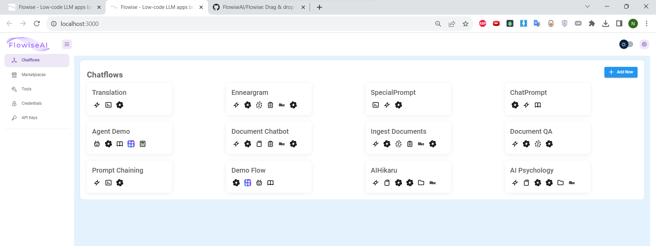
Modeling
FlowiseAI

Slide 26
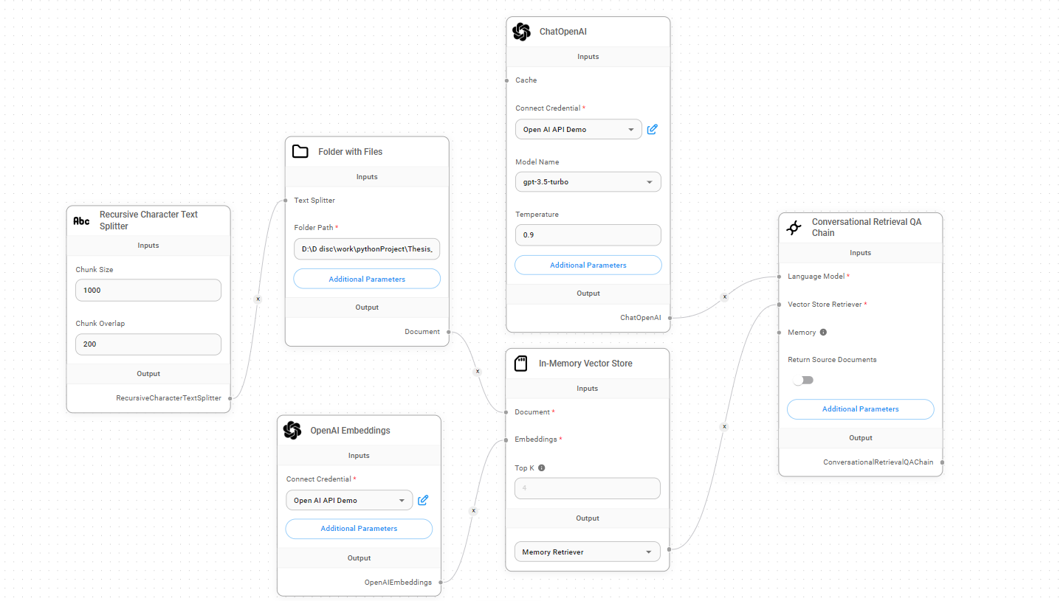
Modeling
FlowiseAI

Slide 27
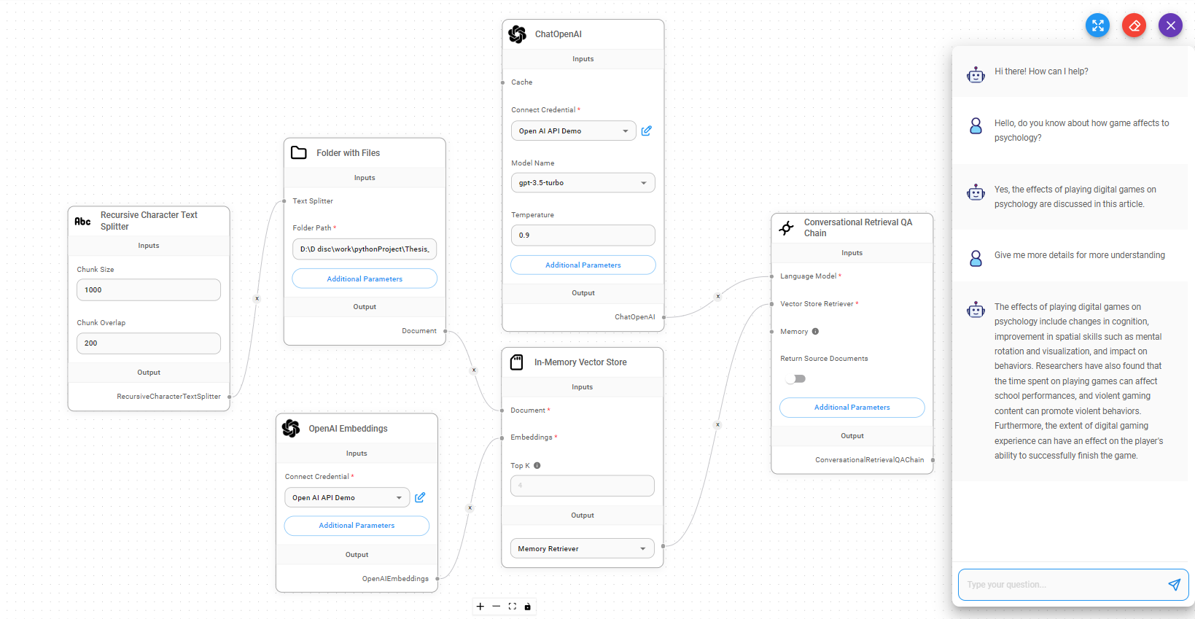
Modeling
FlowiseAI

Slide 28

05
Conclusion

Slide 29
Thanks!
Do you have any questions?

